Slide 1

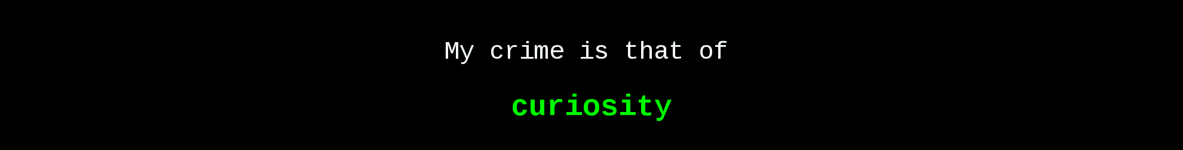
Practical Assessment
Revision 1

Slide 2
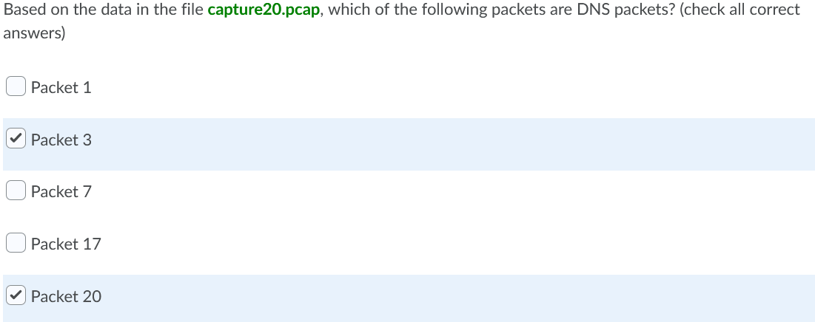
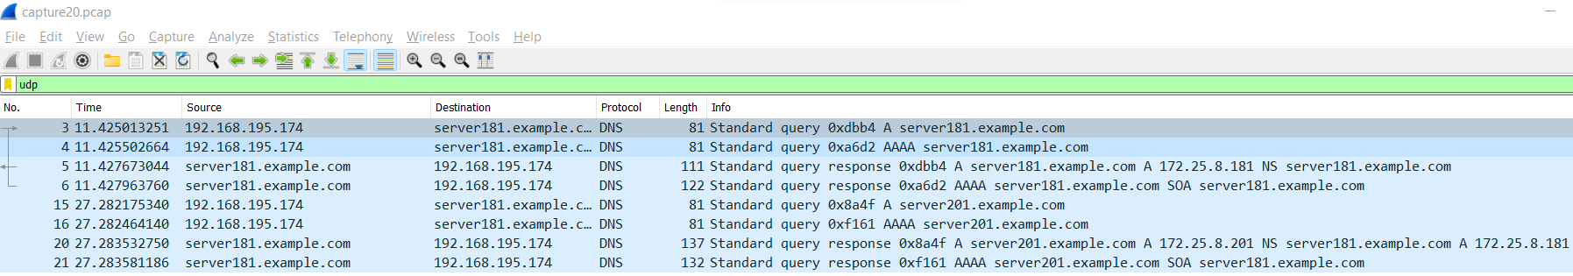
Practical Assessment 1 - Revision
Q1
You can use filter search either for
“udp.port==53” since DNS uses UDP as transport protocol, OR
Simply “udp”
Simply “dns”
Remember, the search filter is CASE SENSITIVE!!!

Slide 3
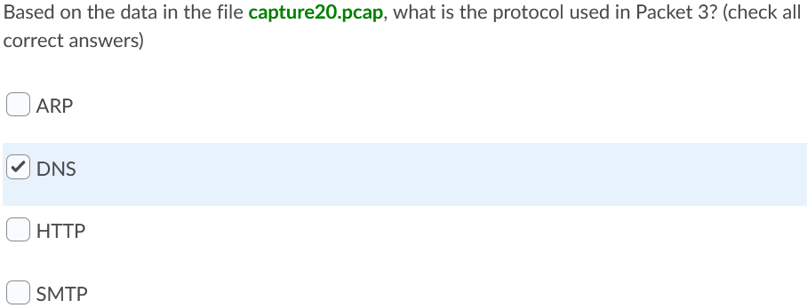
Practical Assessment 1 - Revision
Q2

Slide 4
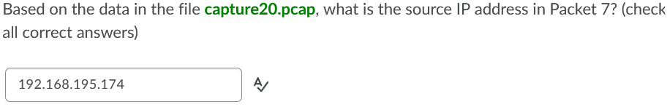
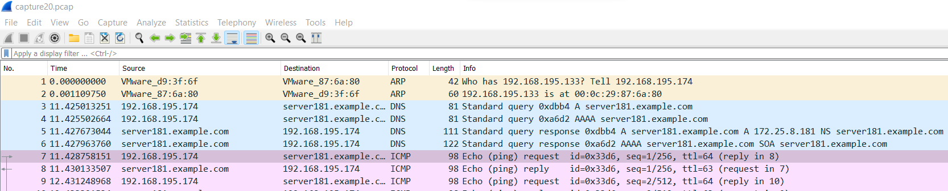
Practical Assessment 1 - Revision
Q3

Slide 5
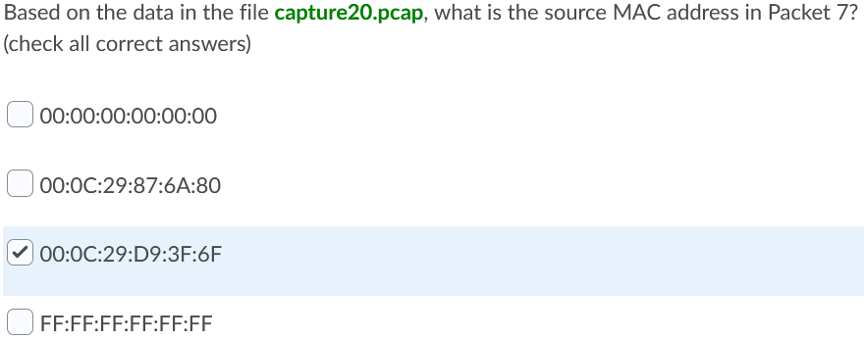
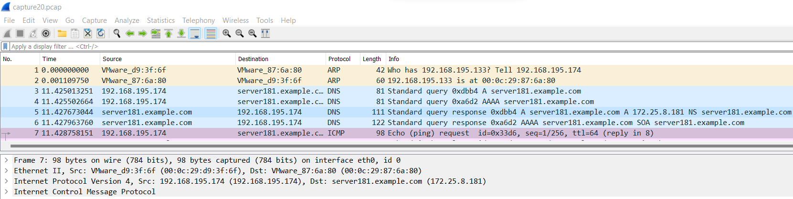
Practical Assessment 1 - Revision
Q4
Remember, MAC addresses belong to Layer 2!!!

Slide 6
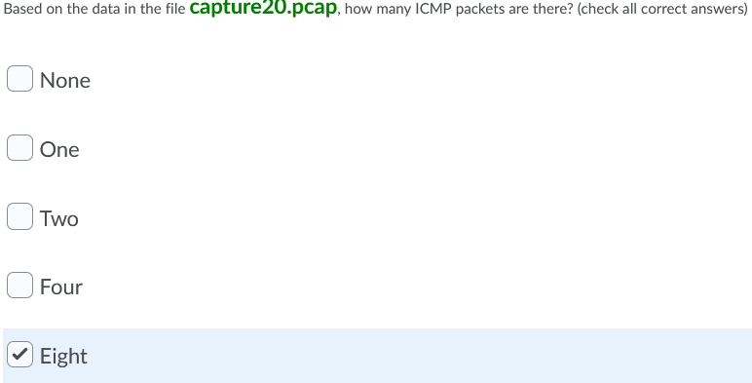
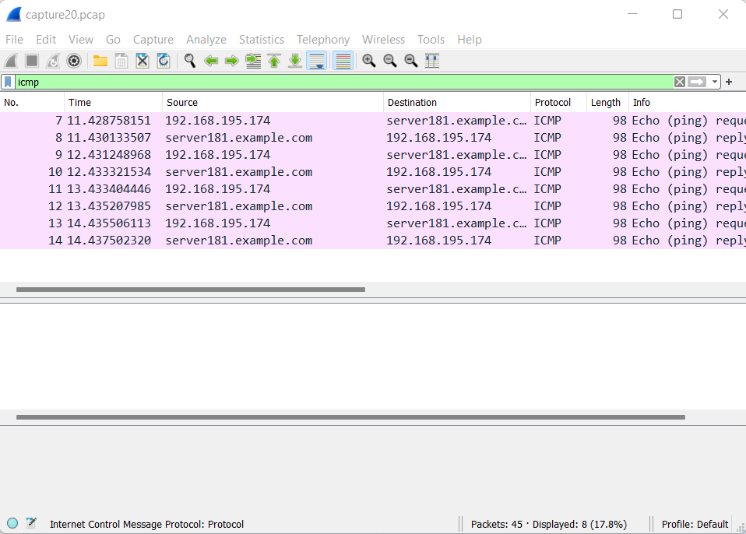
Practical Assessment 1 - Revision
Q5
Number of filtered packets are shown here. No need to count manually!

Slide 7
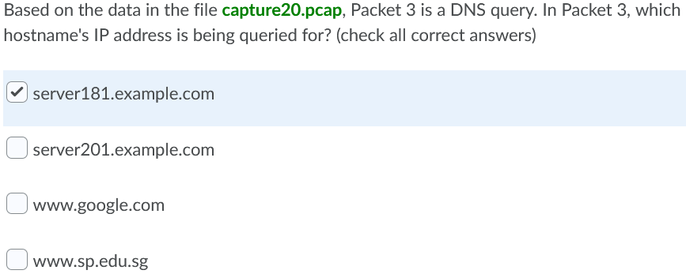
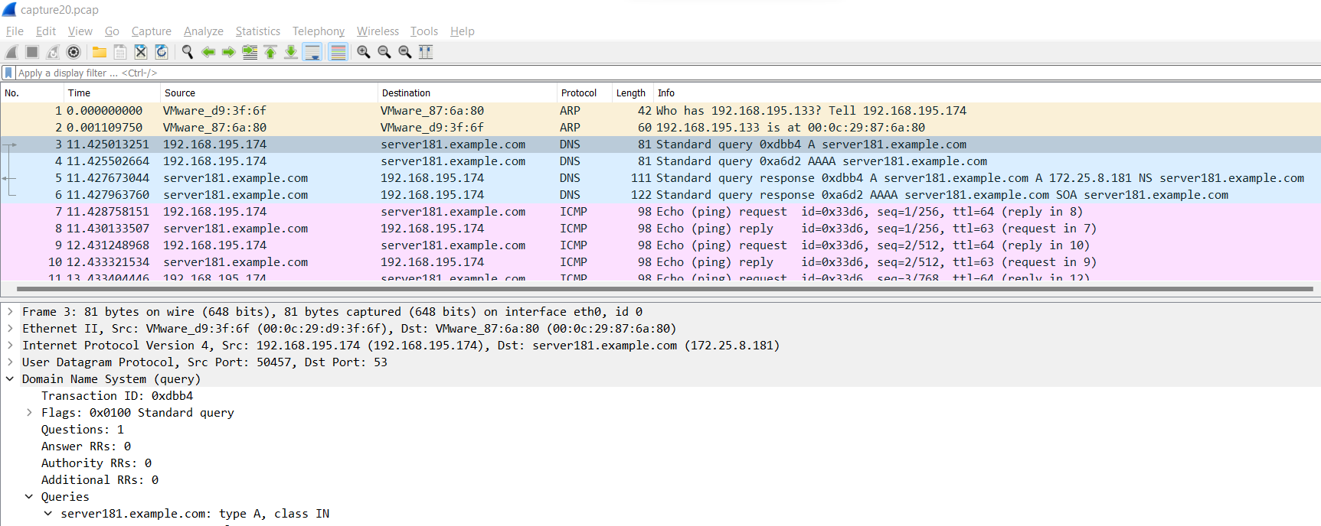
Practical Assessment 1 - Revision
Q6
Can either:
See from the “Info” column, OR
Expand the “Domain Name System” of the packet

Slide 8
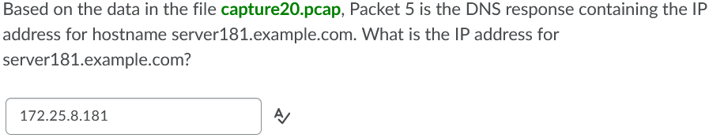
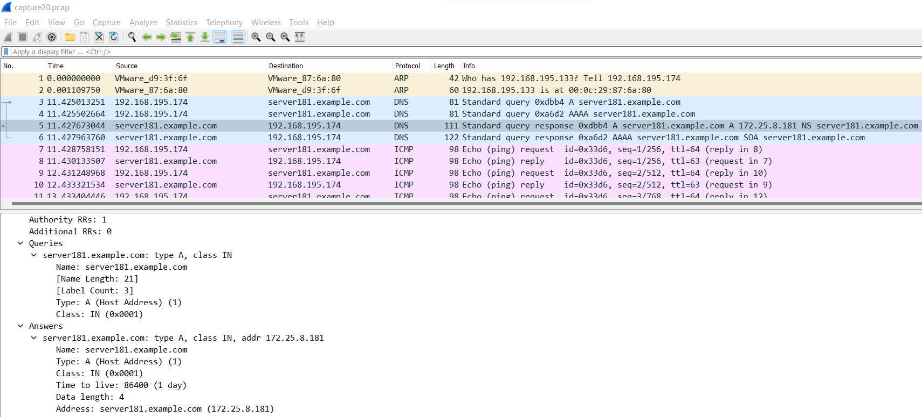
Practical Assessment 1 - Revision
Q7

Slide 9
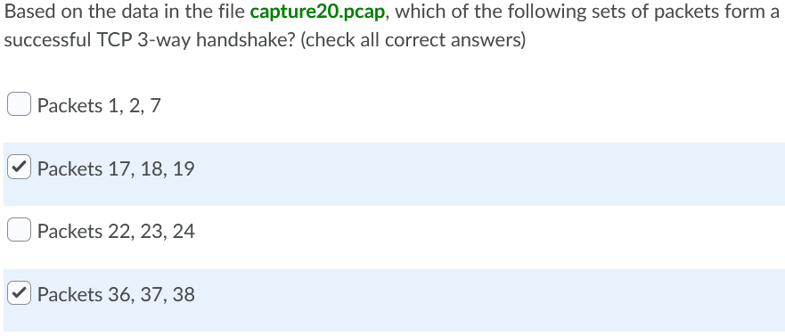
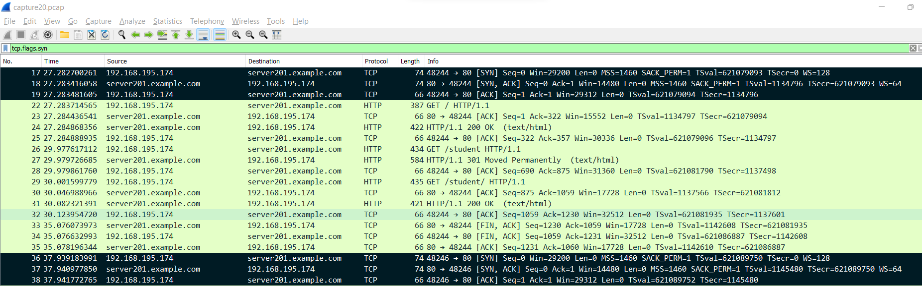
Practical Assessment 1 - Revision
Q8
Remember:
3-way handshake
[SYN → SYN ACK → ACK]
IMPT!:
In a large pcap, sometimes packets may not arrive in neat fashion, esp when there are many handshakes. Always check that the source and destination ports are consistent in a 3-way handshake connection.
In this eg, port 48246 and 80 must be consistent in this 3-way handshake connection.

Slide 10
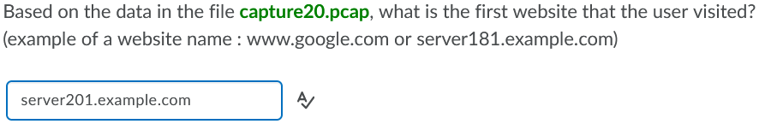
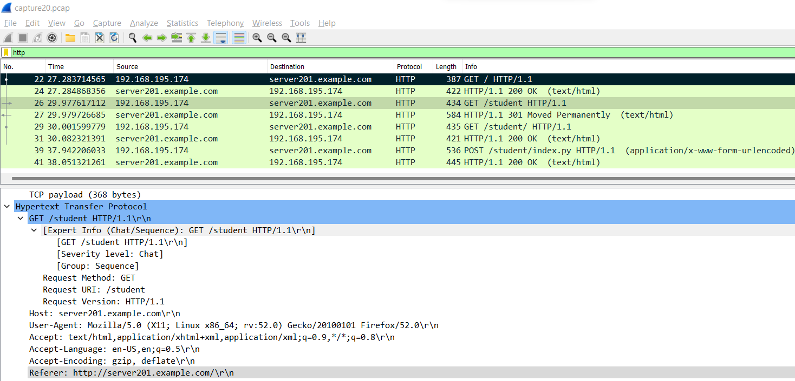
Practical Assessment 1 - Revision
Q9

Slide 11
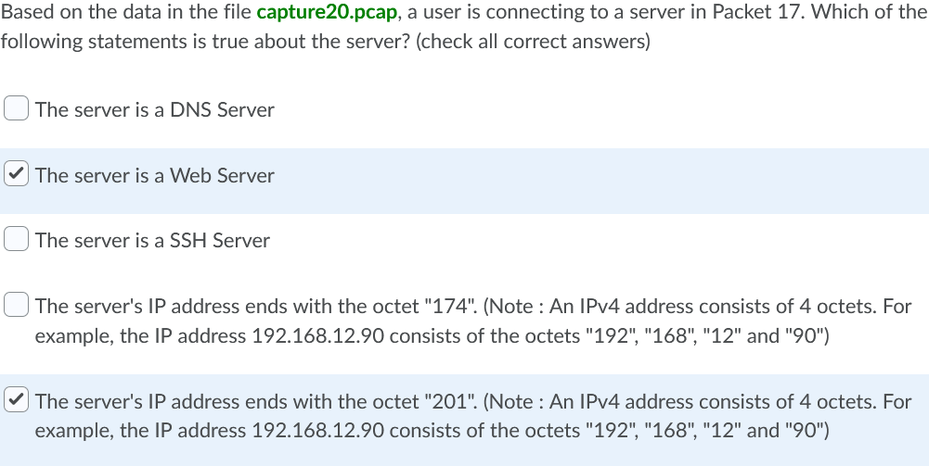
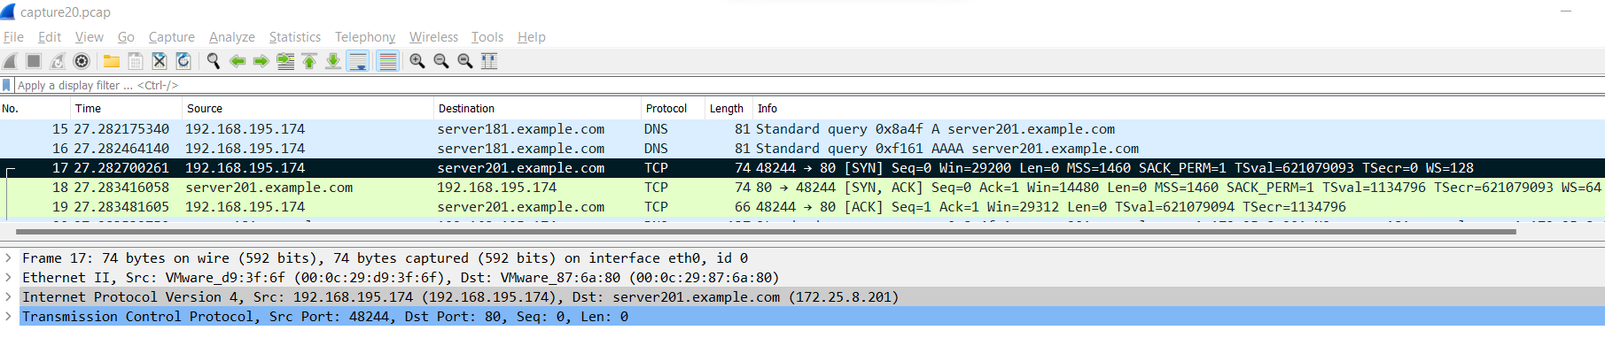
Practical Assessment 1 - Revision
Q10
Remember: The initial ‘SYN’ packet will always be associated to the desired service port number. In this case, it is TCP 80. And TCP 80 refers to HTTP.
So, server201 is a web server.

Slide 12
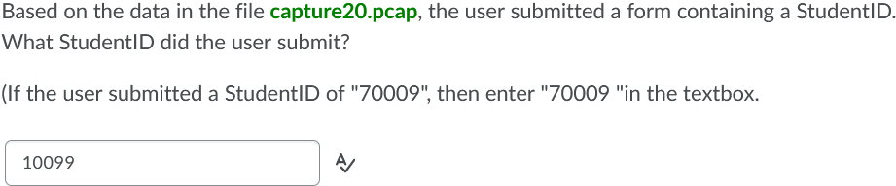
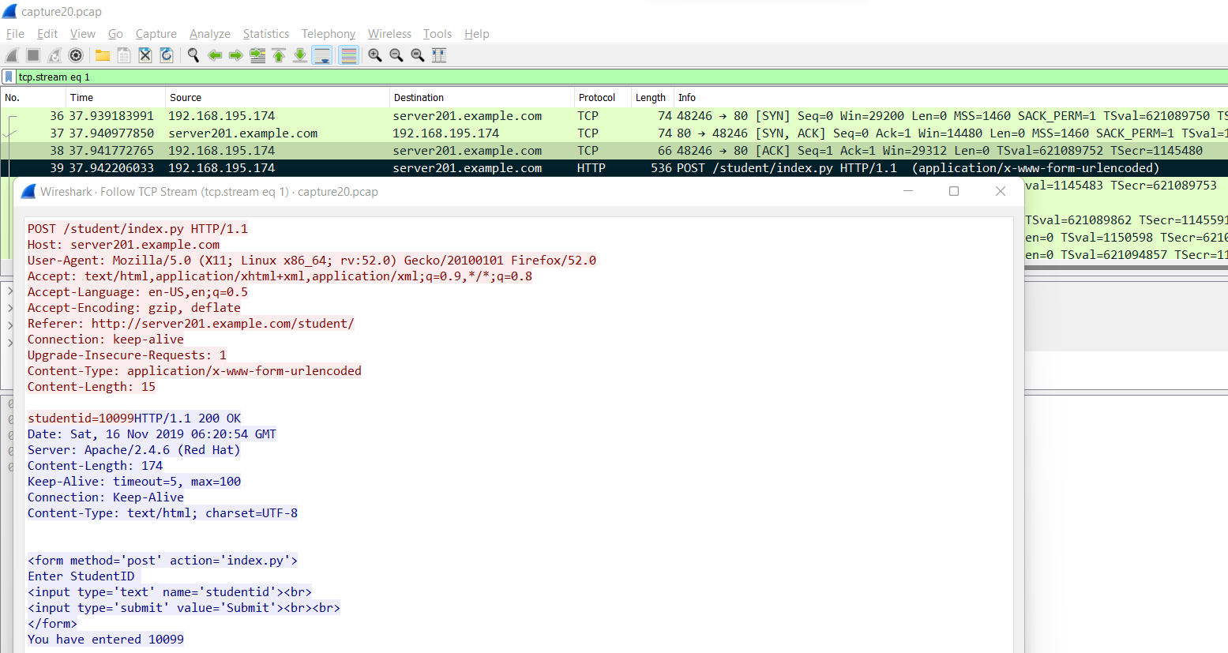
Practical Assessment 1 - Revision
Q11
POST is used when submitting online forms. In this case, it is at Packet 39.
A TCP Stream of Packet 39 will reveal the submitted information.

Slide 13
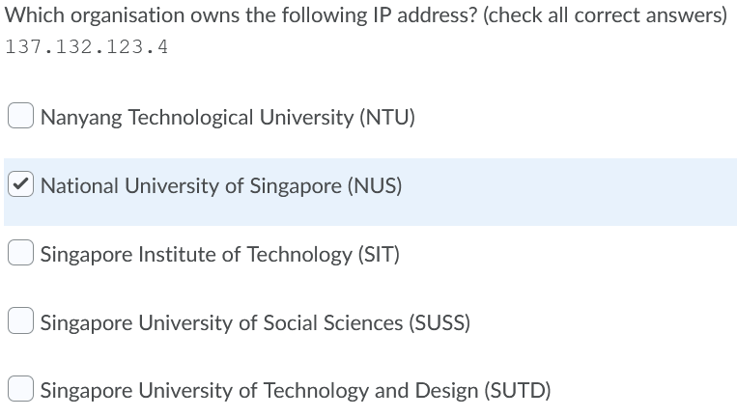

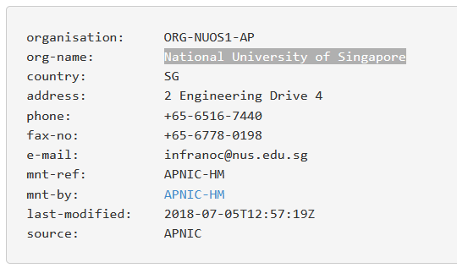
Practical Assessment 1 - Revision
Q12
REMEMBER: You can use any means to find an answer, not just a specific method.
I simply used an online search engine for IP address for this.

Slide 14
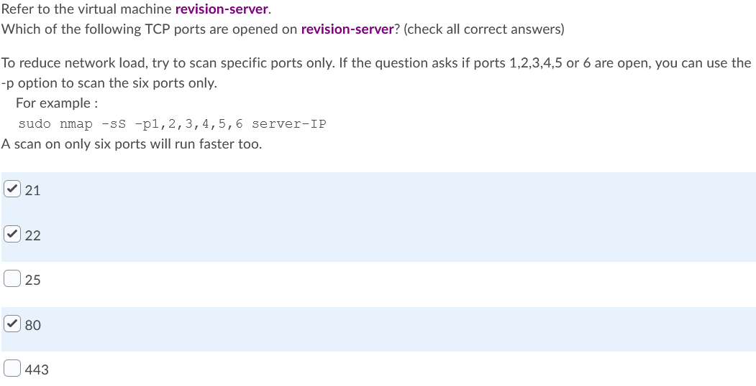
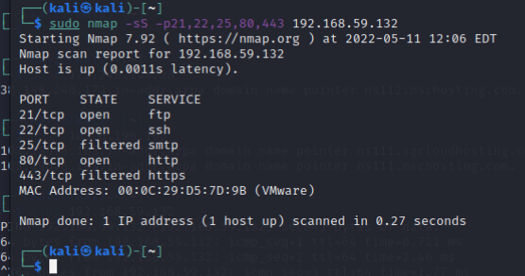
Practical Assessment 1 - Revision
Q13

Slide 15
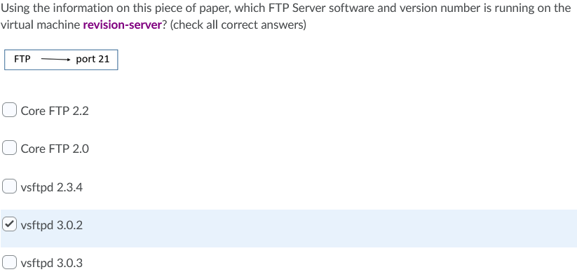
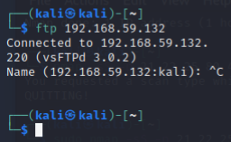
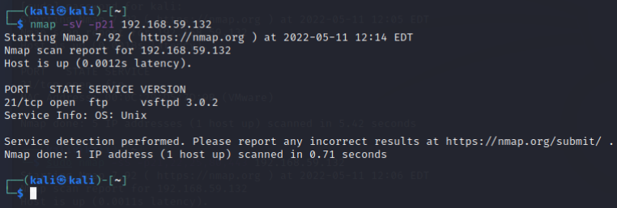
Practical Assessment 1 - Revision
Q14
Remember: There are more than one method to get the software version.
Attempt an FTP connection OR
Do nmap scan with the VERSION (-sV) switch

Slide 16
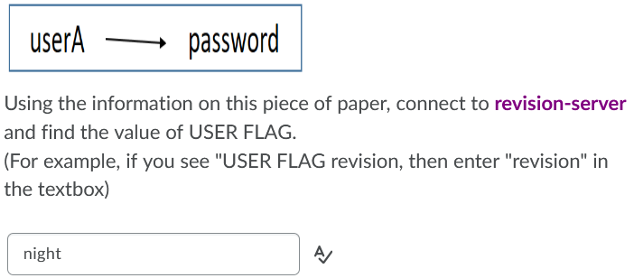
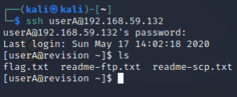
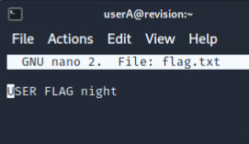
Practical Assessment 1 - Revision
Q15

Slide 17
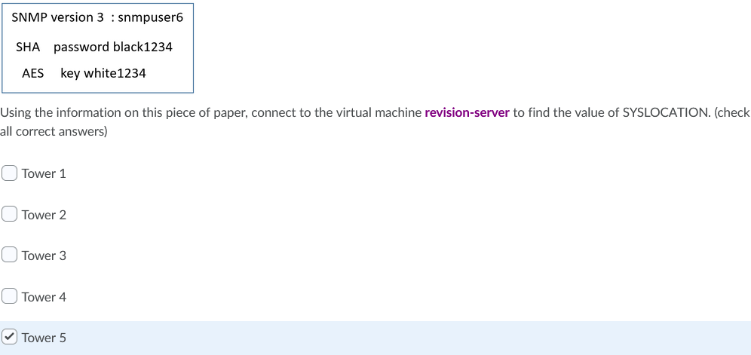
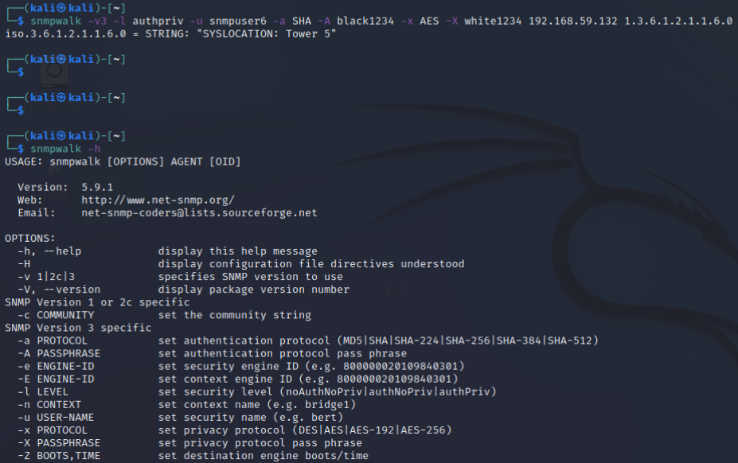
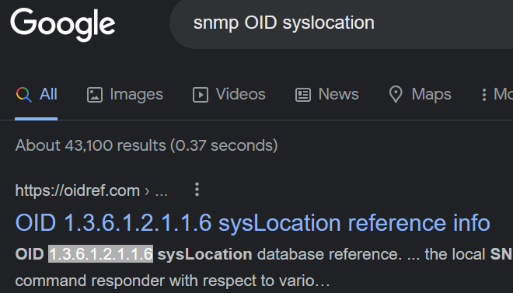
Practical Assessment 1 - Revision
Q16
General syntax → snmpwalk <options> webserver-IP <sysLocationOID>
Commonly used syntax
snmpwalk -v3 -l authpriv -u [usrname] -a [authproto] -A [authpwd] -x [encyproto] -X [encypwd] [tgtIP] [OIDnum]
It is impossible to memorise the inexhaustible list of numeric OID.
Just simply ask Mr G for the numeric string of the particular OID you want.
In this case, the wanted OID is syslocation.

Slide 18
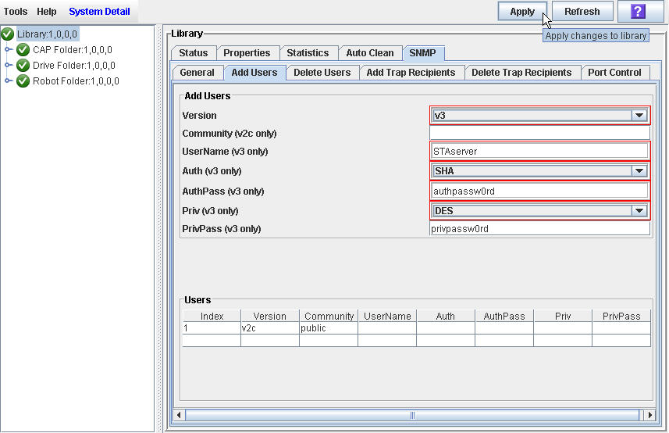
Practical Assessment 1 - Revision
Q16

Slide 19
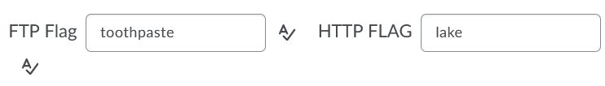
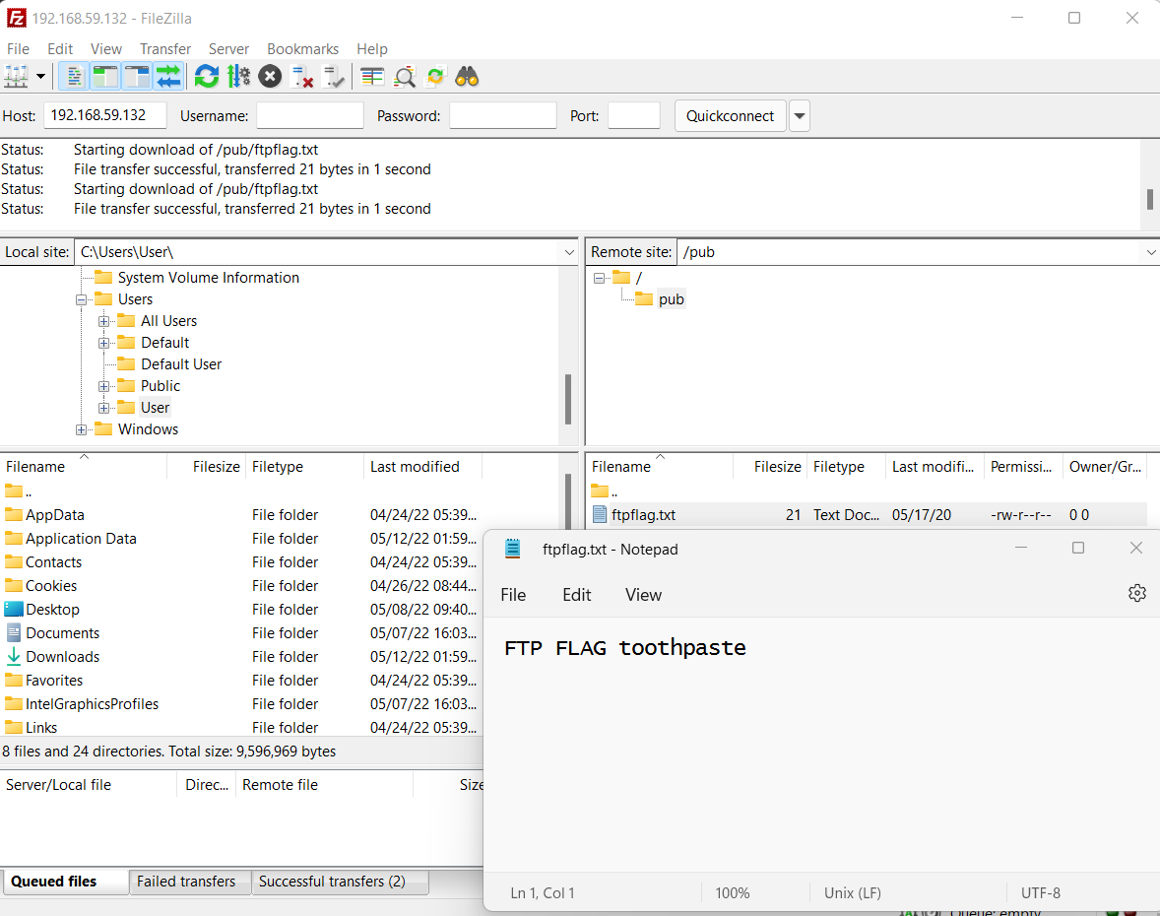
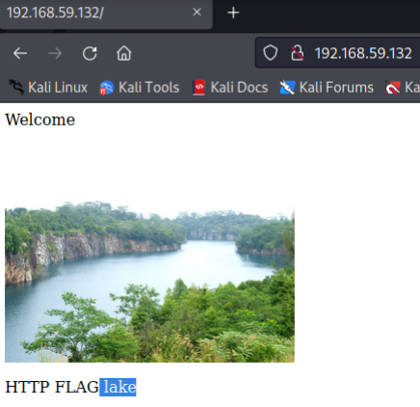
Practical Assessment 1 - Revision
Q17
I used FileZilla on Windows
REMEMBER: You can use any means to find the flag, not limited to the given kali linux.
I used Firefox on Windows

Slide 20


